Slide 1
Using Machine Learning to Predict Fibonacci’s Sequence
Takiya Eastmond,
Deandre Charity,
Donald Davis,
Xavier Johnson,
July 15, 2022

Slide 2




Meet our amazing Team!
Donald Davis
Lead Code Designer/
Backup Auditor
Xavier Johnson
Auditor/
Backup Writer
Deandre Charity
Note Taker/Writer
Takiya Eastmond
Project Lead/ Presentation Designer

Slide 3
What we will discuss..
What is Fibonacci’s Sequence?
What is valuable about this structure?
Our goals for this project.
Exploratory Data Analysis
Data Preparation
Models: RNN using Relu
Results
Future Research Implications
References
Questions

Slide 4
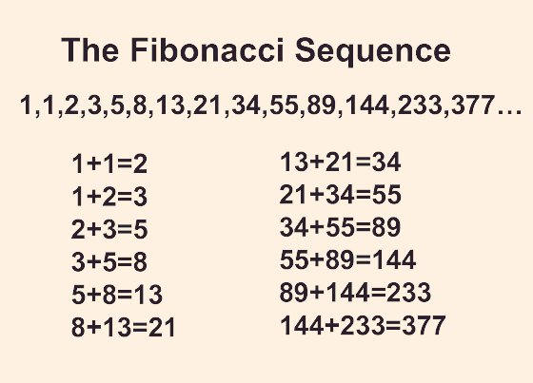
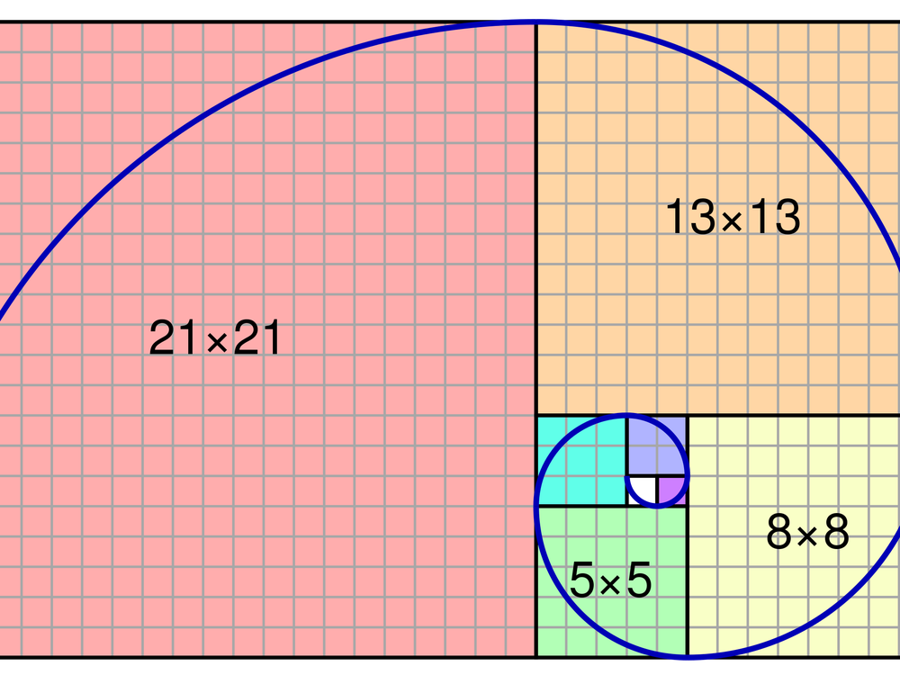
What is Fibonacci’s Sequence?
The Fibonacci Sequence is the series of numbers where each number is the sum of the two preceding numbers.
This sequence derived from Leonardo of Pisa, better known as, Leonardo Fibonacci, in his attempt to discover how many rabbits can be produced from a single pair of rabbits in one year under ideal conditions.
Mathematically we can describe this instance as:
X_{n} = X_{n-1} + X_{n-2}

Slide 5
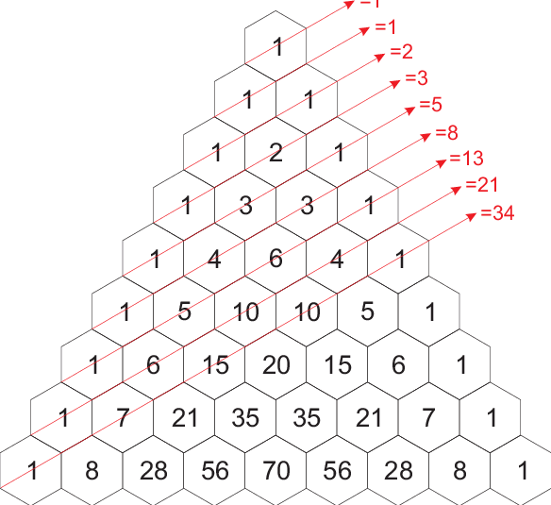
How the equation works
Start: At the start no rabbits are born because they have not had time to become pregnant. (0).
The first month: One pair of rabbits are born, producing. (1).
The second month: Again, one pair of rabbits are born. The new rabbits cannot bear young. (1).
The third month: Two pairs of rabbits reproduce, and one pair is not ready, so two pairs of rabbits are born (2).
The fourth month: Three pairs of rabbits reproduce, and 2 pairs of rabbits are not ready, so three pairs of rabbits are born (3).
The fifth month: Five pairs of rabbits produce and three are not ready, so five pairs of rabbits are born (5).
And so on.
A Pascal's Triangle Fibonacci Sequence Mapping

Slide 6

Importance
A real-life situation that this sequence can be applied to is to estimate the time it takes to complete a task.
Agile teams need to estimate the time it takes to complete tasks, making for a more efficient collaboration.
This is executed by implementing a point system that can be used to give a high-level estimate of the scale of a specific task.

Slide 7
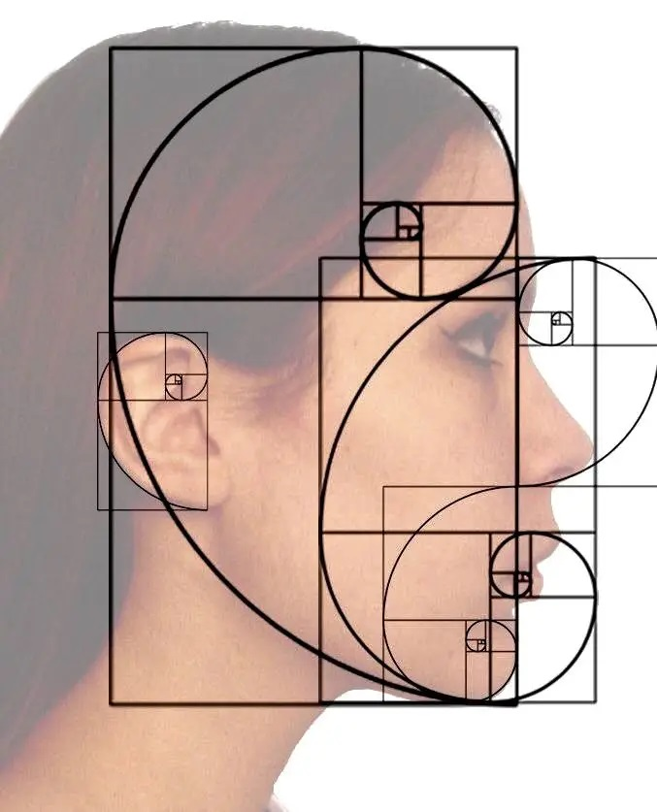
Goal(s) of the Project
Fibonacci's sequence can be determined through handwritten mathematical equations. This method is tedious and leaves room for great error.
The goal of our project was to create a model that determines Fibonacci's sequence quickly, and accurately.
We will construct a recurring neural network (RNN) model to predict Fibonacci's sequence based on a predetermined sequence of data.

Slide 8
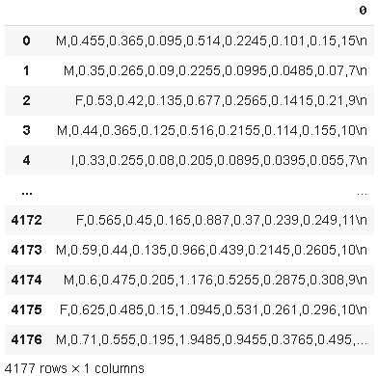
Exploratory Data Analysis
We uploaded file and converted it into a dataframe (or table).
We found that the data loaded into one column.
Every row was combined into a string (combination of characters). These needed to be separated.

Slide 9

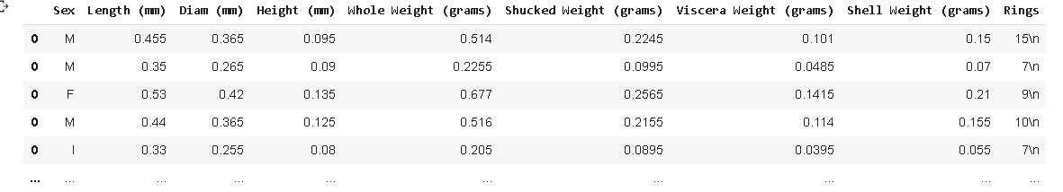
Exploratory Data Analysis (Continued)
In the top image is a value from the original data. Using a for loop, we separated each value by the commas. We then put them in separate columns of a new data frame.
Next, we took the column names from one of the files.

Slide 10

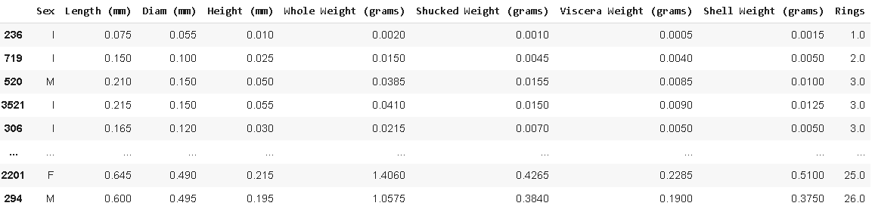
Exploratory Data Analysis (Pt. 3)
The Rings values had a ‘\n’ that needed to be removed. A for loop was used for this.
Lastly, we fixed the index values and sorted the data by the number of rings.

Slide 11

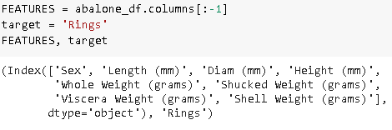
Data Preparation (Model 1)
The Sex column values were changed to numbers.
The target (y) was set as the ‘Rings’ column.
All other columns were set as the features (X) that determine the target value.

Slide 12
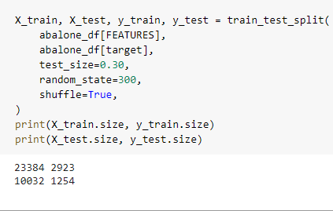
Data Preparation (Continued)
We split the data. 70% of the data. was used to train the model to predict rings.
30% of the data was used to test the model’s ability to predict the total rings.

Slide 13
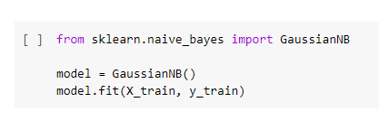


Model 1
We imported Gaussian Naive Bayes Classifier.
The data was trained using the training set.
The model predicted the testing target values using the testing features.
The accuracy of the model was low.

Slide 14
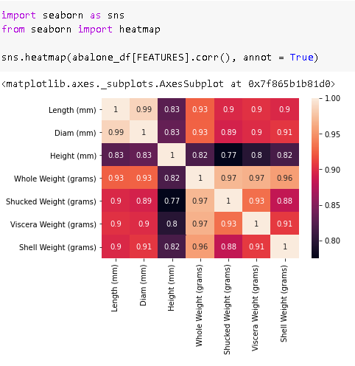
Model 2
We made a correlation heatmap of the feature columns.
Some columns had a correlation near 1 (which makes values dependent on one another)

Slide 15

Model 2 (Continued)
We selected 4 dependent features. We made an array of them to remove.
There was a small accuracy difference compared to model 1.

Slide 16
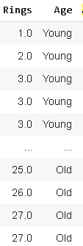
Model 3
Abalones were grouped by their number of rings. Features stayed the same as model 1
Young abalones have less than 5 rings.
Middle age abalones have 5 to 15 rings.
Old abalones have more than 15 rings.

Slide 17
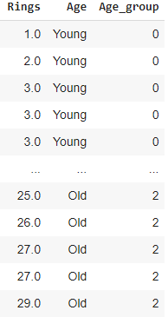
Model 3 (Continued)
The new target is a number key for the different ages (Age column).
Young abalone are in Age_group 0, Middle Age is 1, and Old is 2.
The accuracy greatly increased compared to the first 2 models.

Slide 18

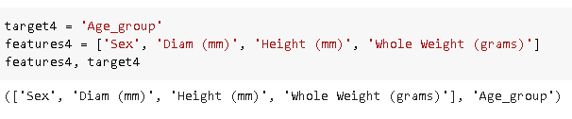
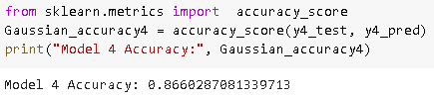
Model 4
This combines the ideas for models 2 and 3.
The reduced features from model 2 were used.
The new target column from model 3 was used.
Model 4 had an increased accuracy from model 3 (86%).

Slide 19
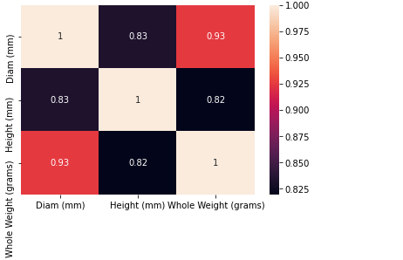

Model 5
The first thing done for the last model was correlation heatmap of model 4’s features.
We took out 1 more feature from model 4.
The accuracy increased to 91%.

Slide 20
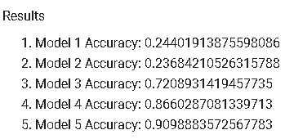
Results
The first 2 models can not predict a precise age due to too many unique (target) values.
Cutting down the number of groups or target values made the predictions more accurate.
We also found that removing features with a high correlation had the same effect with fewer groups.
In conclusion, these two factors gave model 5 the highest accuracy of about 91%.

Slide 21
Future Research Implications
This research can be used to gauge the ages of other animals who are endangered. Understanding how long the population is living gives a sign of where actions are needed to save the animal.
Perhaps our research could assist the medical field, as abalone can provide several health benefits as well.
This research may also be applied in restaurants to determine the price and quality of abalone before purchases.

Slide 22
Works Cited
“The Fibonacci Sequence.” Imagination Station, www.imaginationstationtoledo.org/about/blog/the-fibonacci-sequence. Accessed 15 July 2022.
Velasquez, Robert. “What Is The Fibonacci Sequence? And How It Applies To Agile Development.” eLearning Industry, 12 May 2021, elearningindustry.com/fibonacci-sequence-what-is-and-how-applies-agile-development.

Slide 23


